Slide 1
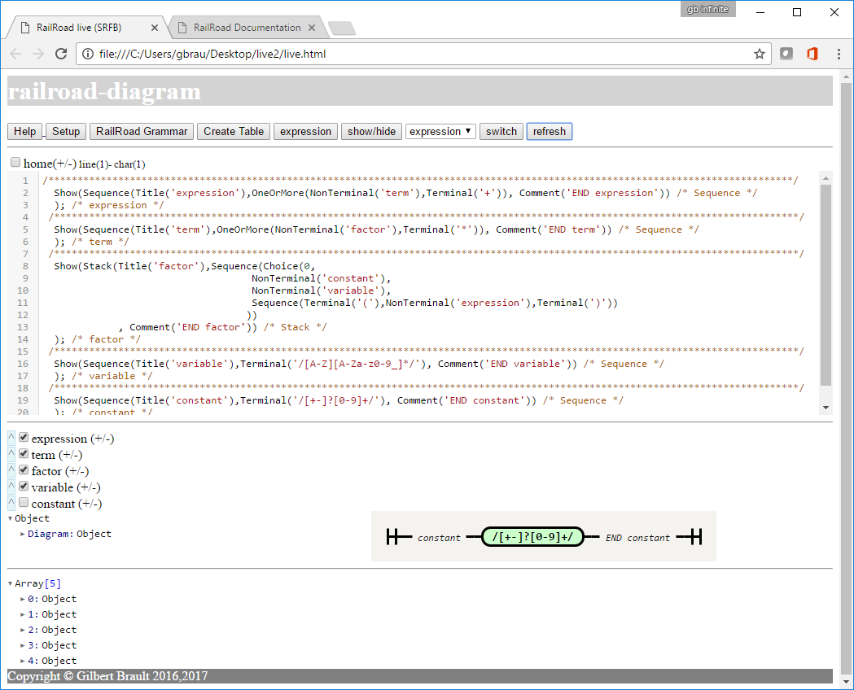
Show/Hide unchecked
Diagrams
a
Banner
1
b
Help
Navigation
2
c
Set Parameters
Select
Grammars
Or default
associated expression
d
Grammar
Editor
3
e
Select grammar expression type to validate
f
Switch from grammar to expression editor
Tree &
Syntax Diagram
4
g
Refresh or
Validate (expression)
Input
Show/Hide (checked = item hidden)
Result
Show/Hide tree node
EBNF
5
Navigation
Structure
Footer
6

Slide 2
